Slide 1
Predicting Breast Cancer Based on Anthropometric Data
Niroshan Balasuriya

Slide 2
Introduction
Breast cancer is a common cancer type among women. In 2020, 2.3 million women have diagnosed with breast cancer and 685,000 deaths globally.
Machine Learning provides statistical, probabilistic and optimization techniques in detecting patterns from different data sets.
This is one of the best approaches that can be used in detecting serious medical conditions such as cancer.
In this research, it is mainly focused on the predicting a breast cancer based on anthropometric data and parameters which can be easily collected from routine blood analysis.

Slide 3
About the Data Set
The selected data set is a collection of data that indicating the presence or absence of breast cancer.
There are 10 predictors, all quantitative, and a binary dependent variable.
The predictors are anthropometric data and parameters which can be gathered in routine blood analysis.
Number of Instances = 116.
Number of Attributes = 10.
44% of the given data set consists of the records from healthy people and 56% are patients. Therefore, the data set distribution can be considered as an acceptable one.

Slide 4
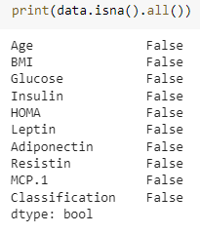
Exploratory Data Analysis and Data Pre-processing
In the selected data set all variables are quantitative and no null values.
Further the data set didn’t contain any missing values.

Slide 5
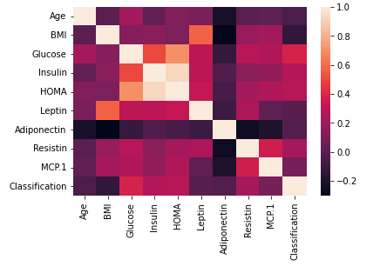
Correlation of the Variables
By examining the below heatmap it shows that the correlation between the variables is low.
As per the below, there is no significant correlation between the variables.

Slide 6
Training Split & Model Training
Data was split in 70%-30% proportion where 70% for the training set and 30% for the test set.
Model was trained using the following classification algorithms.
Random Forest Classifier:
RandomForestClassifier(n_estimators=500, max_depth=10, n_jobs=3, verbose=1)
Decision Tree Classifier:
DecisionTreeClassifier(random_state=0, max_depth=10, min_samples_split=20)

Slide 7

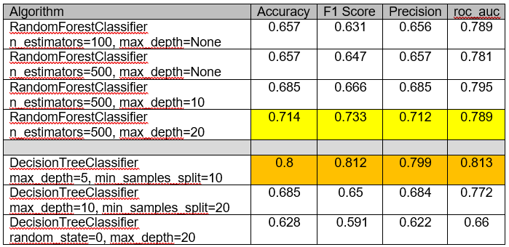
Result Analysis
Below table shows the results achieved from the model execution.
After manual hyper parameter tuning, following results achieved.

Slide 8
Result Analysis
As per above stats it shows that both Random Forest Classifier and Decision Tree Classifier shows better performance with Hyper parameter tuning. Random Forest Classifier shows its best performance at n_estimators = 500 & max_depth = 20. Decision Tree Classifier shows its best performance at max_depth=5 & min_sample_split=10.
Further, Grid Search & Random Search was conducted on the Random Forest Classifier. In both occasions, “n_estimators=100, max_depth=None” selected as the best model but the performance pretty much similar to the above.
In both searches, it showed that MCP.1, Insulin & Adiponectin as the least important features.
Model was retrained from the Random Forest Classifier and ran after dropping the above three columns from the data set. There is no significant improvement shown.

Slide 9
Conclusion
Breast cancer has become one of the major cancer type among the women throughout the world.
Machine learning can be adopted for cancer detection and prediction. In this research, Breast Cancer Coimbra Data Set which consists of clinical features of 116 patients was used to develop a machine learning model to predict cancer patients.
Random Forest Classifier and Decision Tree Classifier were used as the primary algorithms. Decision Tress Classifier was identified as the best performed algorithm for this model.

Slide 10
Thank You!

